Slide 1


SkillRadar
Industry-Aligned Skill Evolution Prediction Engine
Team Name: Tech Defender
Anish D
Piruthiviraj G
Kervin S
Kamlesh P
Saveetha Engineering college

Slide 2
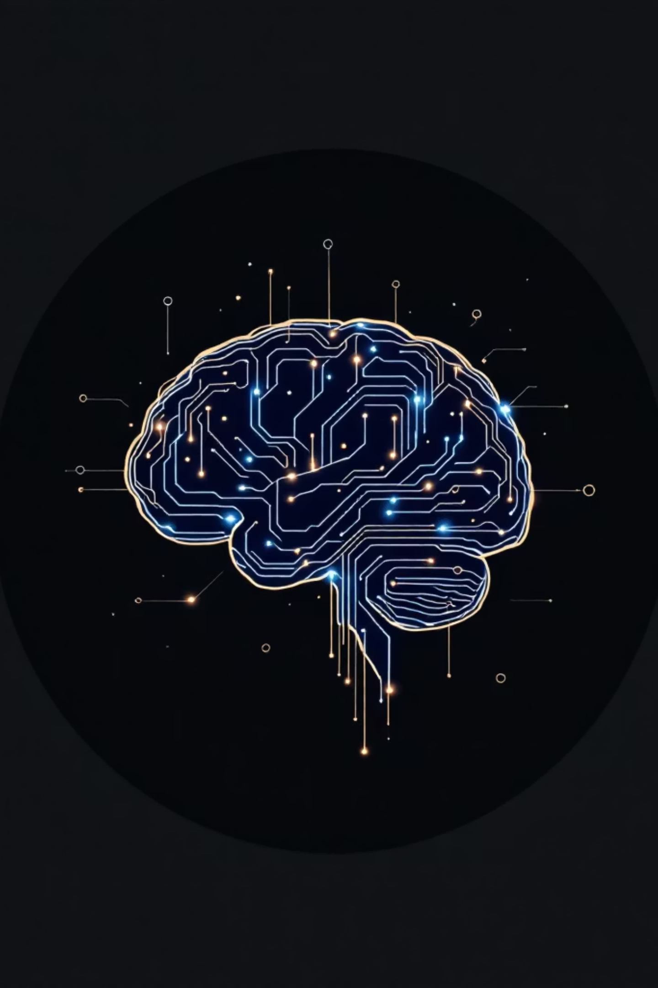
The Skill Evolution Engine
An AI-powered, gamified professional development platform delivered as a desktop application. It analyzes a user's current skills (via resume parsing or manual input), compares them against real-time market demands, and generates hyper-personalized learning pathways to bridge identified skill gaps.

Slide 3
Problem Statement
The Skill Gap Crisis
Clear explanation of the problem: The modern job market evolves rapidly, making it difficult for professionals and students to know exactly which skills they are missing to land their target roles. Generic, one-size-fits-all course recommendations lead to wasted time and low engagement.
Who is affected?
Current limitations / gaps in existing solutions
Job seekers, students transitioning into the workforce, and professionals looking to upskill or pivot careers.
Most learning platforms (like Coursera or Udemy) operate as static course catalogs. They lack dynamic, AI-driven assessment of a user's starting point (their resume) and do not provide continuous, gamified progression tied directly to live job market data and future demand forecasts.
Why is this problem important?
The widening "skill gap" leads to unemployment for individuals and talent shortages for enterprises. Efficiently aligning individual learning with market needs is critical for economic mobility.

Slide 4




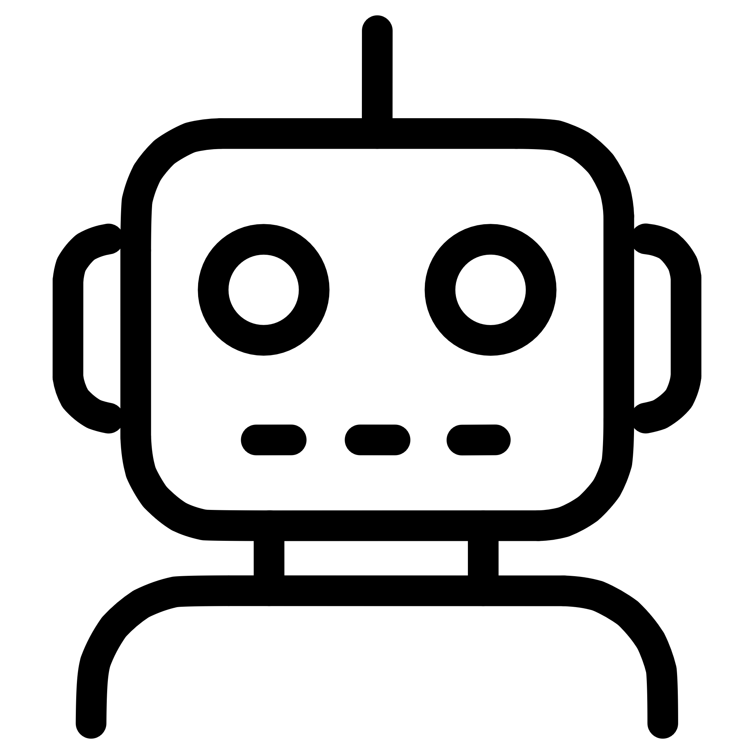
Proposed Solution
Your Intelligent AI Career Coach
Overview of your idea: An intelligent desktop application that acts as a continuous AI career coach. Users upload their resumes, and the system intelligently extracts existing competencies and builds a customizable learning journey toward their dream job.
How your solution addresses the problem: It eliminates the guesswork in upskilling by providing a concrete, step-by-step roadmap. Instead of overwhelming the user, learning is broken down into gamified micro-assessments that validate skills and reward progress (XP and Leagues).
Key Features
Gap Analysis & Pathway Generation
Forecasting Engine
Gamified Validation
Automated Skill Extraction
Predictive visualization of which skills will be in high demand over the next 12 months.
Users take micro-assessments to "prove" a skill, earning XP and climbing the leaderboard.
Drag-and-drop resume parsing using NLP.
AI mapping of current skills to target role requirements.
Interactive AI Coach
A built-in chat interface for personalized career guidance.

Slide 5




Workflow
Analysis
The NLP engine extracts skills and
compares them to the user's target role.
onboarding
The user creates a secure account
and uploads their resume (or
manually enters skills).
Action
Progression
The system generates a personalized
dashboard displaying skill gaps,
recommended courses, and
simulated live job matches.
The user completes micro-
assessments, watches their profile
grow, and checks the forecasting tab
to stay ahead of market trends.

Slide 6
Tech Stack
Technologies & Tools
Programming Languages Used: Python, TypeScript/JavaScript, HTML/CSS
🔧 Backend
🎨 Frontend
📦 Packaging
FastAPI
SQLAlchemy (ORM)
Passlib/Bcrypt (Security)
PyJWT (Authentication)
PyMuPDF (PDF Parsing)
spaCy (NLP)
React (via Vite)
Tailwind CSS
Lucide-React (Icons)
Recharts (Data Visualization)
Pywebview (Desktop Windowing)
PyInstaller (Executable Bundling)
Hardware Components
Database Used
APIs / Tools / Platforms
None (Software-only solution)
SQLite (Designed for MVC/local MVP, strictly typed via SQLAlchemy for future smooth migration to PostgreSQL).
Node.js/npm (Frontend tooling), RESTful API Architecture.

Slide 7
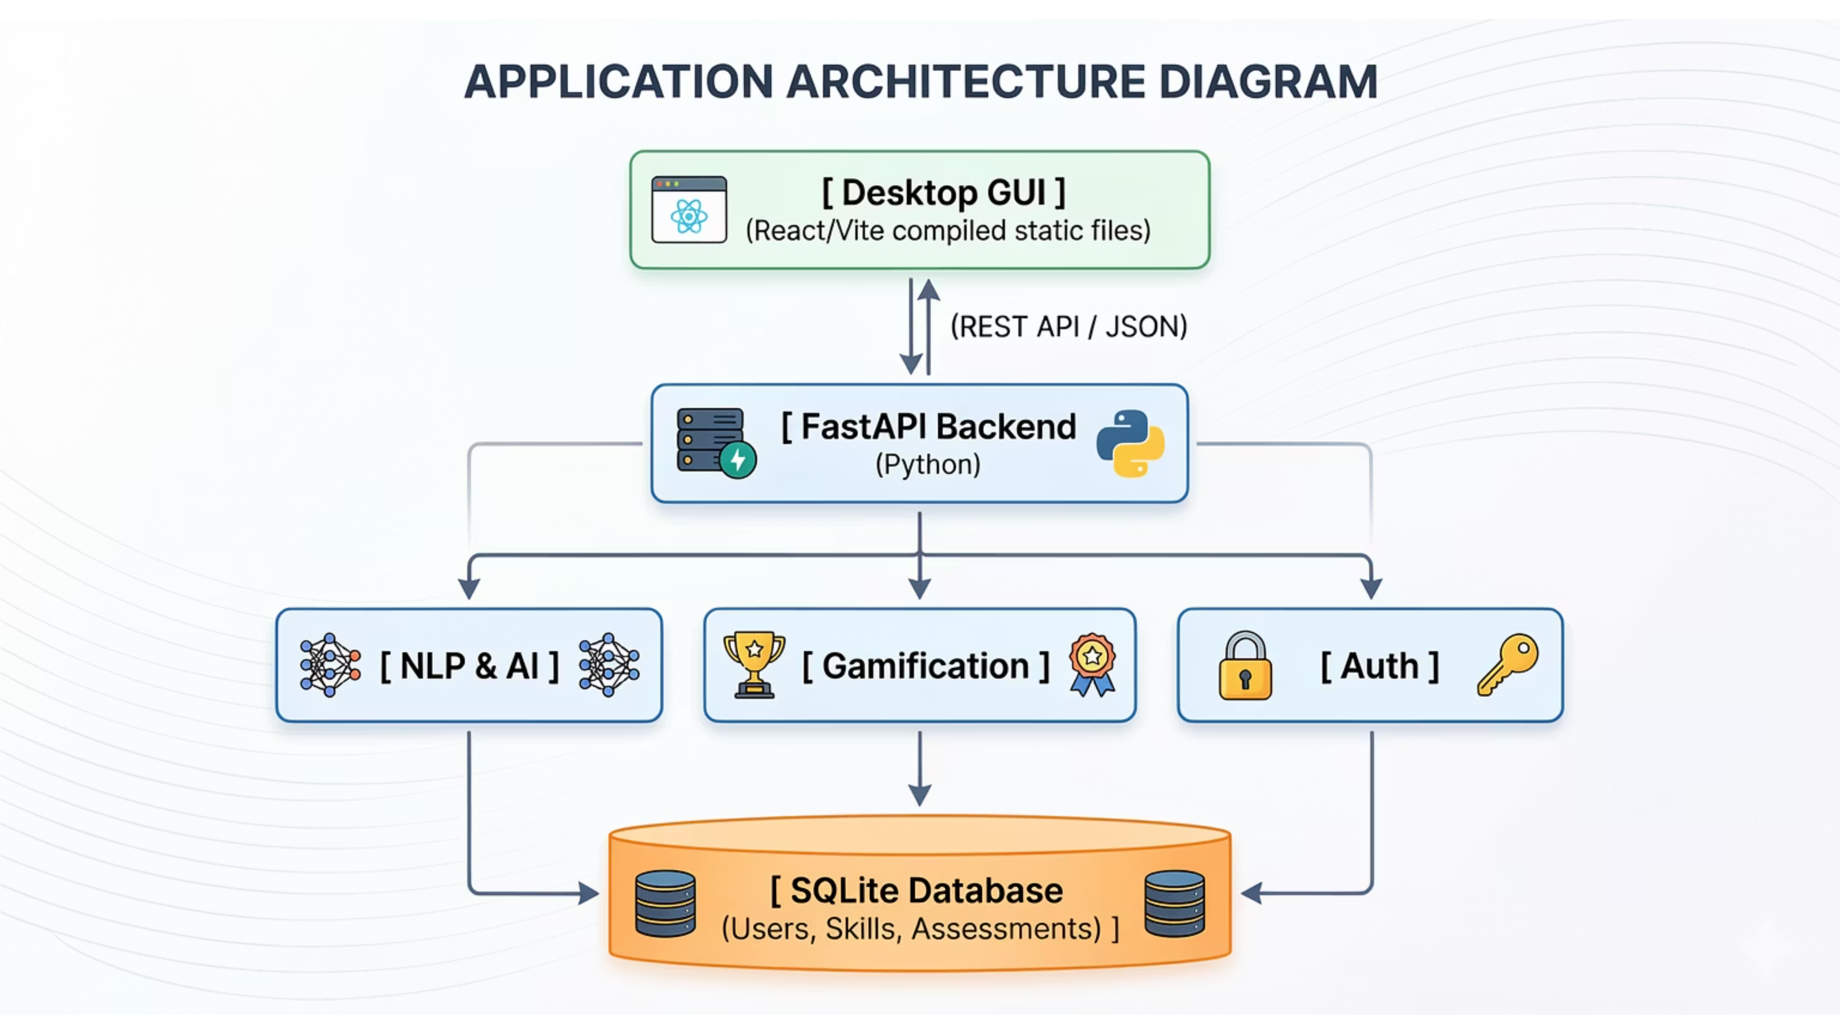
Architecture Overview

Slide 8
Key Architectural Components
01
02
03
Desktop GUI
REST API / JSON Layer
FastAPI Backend (Python)
The user-facing application built with React/Vite, compiled into static files for desktop deployment.
The communication interface enabling seamless data exchange between the Desktop GUI and the FastAPI Backend.
The core server-side application logic, written in Python, orchestrating various services.
04
05
Backend Modules
SQLite Database
NLP & AI: Responsible for parsing documents, extracting entities, and applying AI-driven insights. Gamification: Manages assessment scoring, XP calculation, and leaderboard updates. Auth: Handles secure user registration, authentication (JWT), and password hashing.
The persistent data store, designed for local MVP with strict typing via SQLAlchemy for future scalability.

Slide 9
Data Flow & Innovation
How It All Connects
Data Flow
Innovation & Uniqueness
The user interacts with the React frontend inside a native desktop window. The frontend makes asynchronous API calls (fetch) to the local FastAPI backend. The backend processes the logic (e.g., parsing a resume or verifying a password), reads/writes to the SQLite database via SQLAlchemy, and returns JSON payloads back to the frontend to update the React state.
What makes your solution different? It bridges the gap between an ATS (Applicant Tracking System), an LMS (Learning Management System), and a game. It is proactive rather than reactive.
Novel approach / creative thinking: Delivering a modern, responsive web application as a localized desktop executable ensures low latency, high data privacy (resumes are processed locally), and an uninterrupted focused learning environment.
How Components Interact
Both the backend server and the webview GUI are wrapped into a single executable. The Python script spawns a lightweight local Uvicorn server in a background thread and then opens the Pywebview window pointing to localhost, serving the bundled Vite HTML/JS files statically.
Technical Innovation
Scalability or Adaptability
The integration of predictive forecasting models to tell users not just what is required today, but what will be required tomorrow, allowing them to "skate to where the puck is going to be."
The abstract ORM layer means the database can switch from SQLite to a cloud Postgres instance with a single line of code. The API-first design allows for future deployment as a standard SaaS web app or mobile app with zero backend rewriting.

Slide 10
Conclusion
The Future of Career Development
Summary of solution: The Skill Evolution Engine is a comprehensive, gamified AI career platform that translates user experience into actionable, data-driven learning pathways.
Expected impact: Reduced time-to-hire for users, increased engagement in adult learning, and better alignment of workforce capabilities with rapidly shifting industry demands.
Real-world applicability: Highly applicable to university career centers, corporate L&D (Learning and Development) departments, and individual self-taught professionals.
Future Scope / Enhancements
01
02
03
Live Job Board Integration
LLM-Powered NLP
Multiplayer Features
Integration with real-world job board APIs (LinkedIn, Indeed) for live matching.
Implementation of an LLM (like Gemini or GPT-4) to replace the static heuristic NLP model for deeper contextual resume understanding.
Challenging friends to skill assessments and collaborative learning experiences.

